Slide 1
PMGSY Project Classification Using ML
IBM INTERNSHIP PROJECT
Presented By : R MITHUN
College Name : Meenakshi Sundararajan Engineering College
Department : Information Technology

Slide 2
OUTLINE
Problem Statement
Technology used
Wow factor
End users
Result
Conclusion
Git-hub Link
Future scope
IBM Certifications

Slide 3
Problem Statement
Problem statement : Intelligent Classification of Rural Infrastructure ProjectsThe Challenge:The Pradhan Mantri Gram Sadak Yojana (PMGSY) is a flagship rural development program in India, initiated to provide all-weather road connectivity to eligible unconnected habitations. Over the years, the program has evolved through different phases or schemes (PMGSY-I, PMGSY-II, RCPLWEA, etc.), each with potentially distinct objectives, funding mechanisms, and project specifications.For government bodies, infrastructure planners, and policy analysts, efficiently categorizing thousands of ongoing and completed projects is crucial for effective monitoring, transparent budget allocation, and assessing the long-term impact of these schemes. Manual classification is time-consuming, prone to errors, and scales poorly.Your specific task is to design, build, and evaluate a machine learning model that can automatically classify a road or bridge construction project into its correct PMGSY_SCHEME based on its physical and financial characteristics.

Slide 4
TECHNOLOGY USED
Category | Technology / Tool
Cloud Platform | IBM Cloud Lite (Watsonx.ai, Deployment Spaces)
AutoML Tool | IBM AutoAI
Programming Language | Python
Data Handling | Pandas, NumPy
Model Evaluation | Scikit-learn (for F1 Score, Accuracy, etc.)
Deployment Method | IBM Watsonx Deployment Space (Online REST API)
Model Used | XGBoost Classifier
Input Format | Structured CSV / JSON

Slide 5
Wow factor
Wow Factor : This project transforms traditional rural infrastructure monitoring into a data-driven, intelligent system using cloud-based machine learning. With just a simple JSON input, our deployed model can instantly classify PMGSY schemes with high accuracy (F1 Score: 0.876) — all without writing a single line of model code, thanks to IBM Watsonx AutoAI.
Real-Time Predictions: Model deployed as a REST API predicts the PMGSY scheme instantly from structured JSON input.
No-Code Model Training: Utilized IBM Watsonx AutoAI to build and tune the best-performing model without manual coding.
High Accuracy Achieved: Achieved a macro F1 Score of 0.876, ensuring dependable classification across multiple schemes.
Government Dataset Used: Trained on real-world PMGSY data from AI Kosh, covering road, bridge, and financial metrics.
Fully Cloud-Based: Hosted on IBM Cloud Lite with end-to-end workflow — from training to deployment — in one platform.
Policy Impact Potential: Enables scalable, intelligent decision-making for rural infrastructure planning and budget allocation.

Slide 6
End users
End Users : This solution is designed for use by government departments, planners, analysts, and implementation agencies involved in rural infrastructure projects. It enables faster classification, smarter decision-making, and scalable integration into digital governance systems.
Government Departments: Rural development departments at the state and central levels can use the model to classify projects quickly, improving efficiency and reducing manual workload.
Policy Makers and Planners : Infrastructure planners and policy analysts can use scheme classifications to guide fund allocation, project tracking, and long-term planning.
Implementation Agencies : Public works departments and contractors can use scheme-level insights to organize, schedule, and manage on-ground project execution effectively.
Data Analysts : Those working with government datasets can integrate the model into reporting tools and dashboards to automate tagging and generate insights.
AI/ML Researchers : Researchers in machine learning and public infrastructure analytics can use this project as a foundation for developing more advanced or specialized models.
Digital Governance Bodies : Government bodies and organizations promoting digital transformation can incorporate this system into portals and apps for real-time project intelligence.

Slide 7
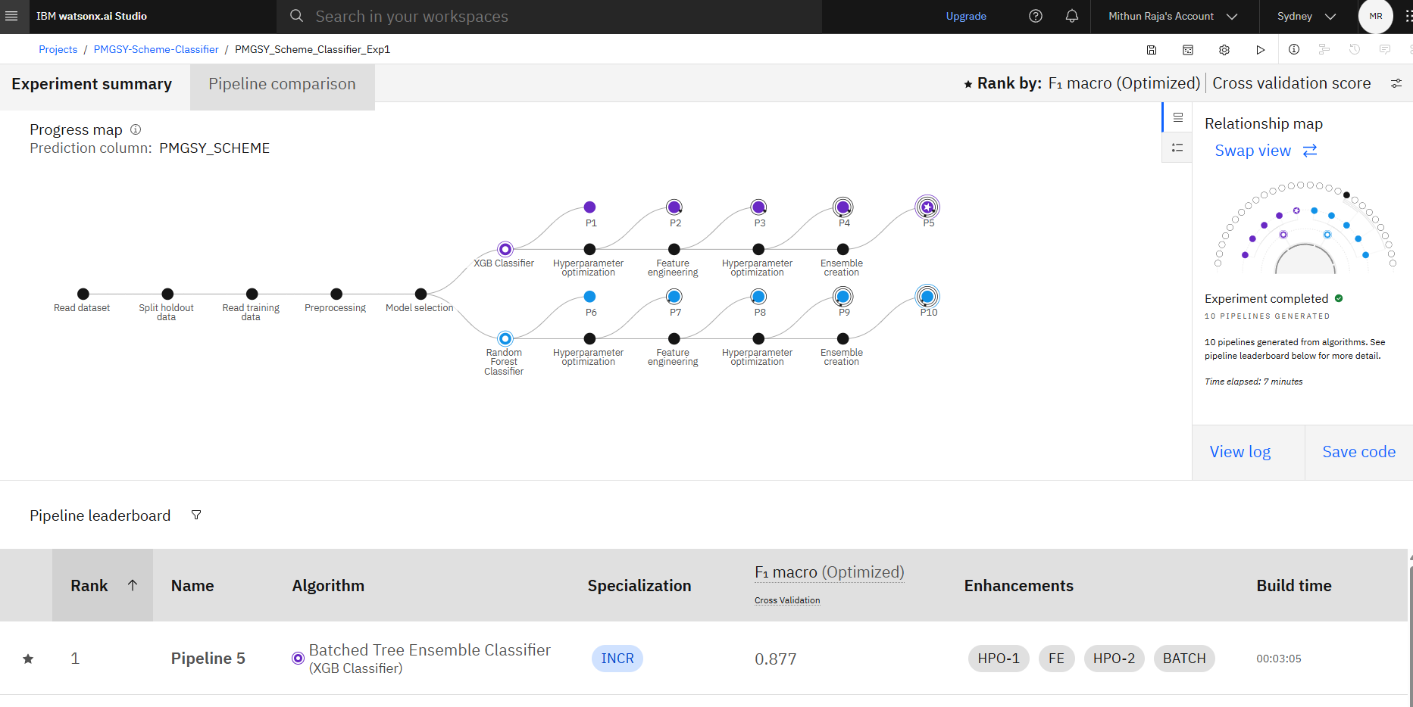
Result
AutoAI built and evaluated multiple pipelines automatically.
XGBoost was selected as the best model based on F1 score.
Included automated preprocessing and feature engineering steps.

Slide 8
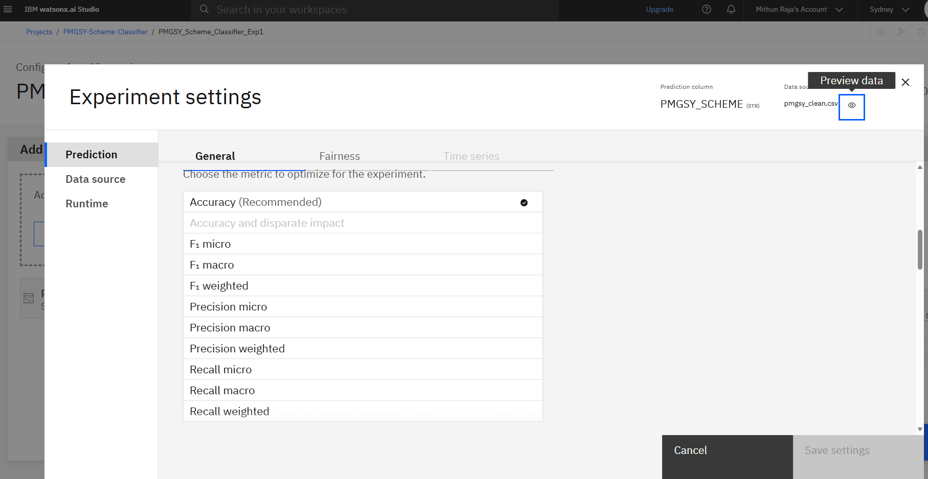
Result
Metric Matters: Choosing the right evaluation metric like F1 or Accuracy directly impacts the model’s learning focus.
Tailored Optimization: Experiment settings allow customization of what the model should prioritize—precision, recall, or overall balance.
Strategic Selection: For PMGSY classification, accuracy ensures correct scheme assignment across varied project types.

Slide 9
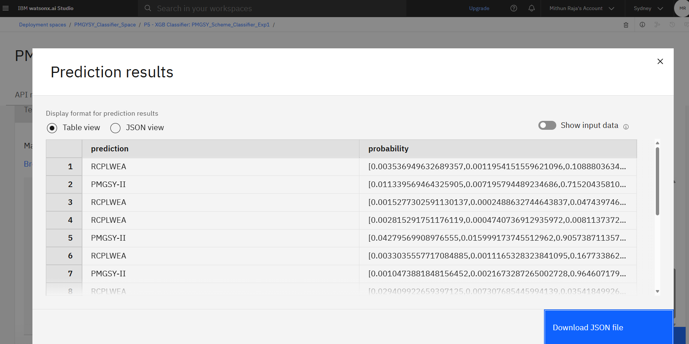
Result
The model trained using IBM Watsonx AutoAI selected XGBoost as the best-performing algorithm.
Achieved a strong F1 Macro Score of 0.876, indicating high accuracy across all PMGSY scheme classes.

Slide 10
Conclusion
Conclusion :The PMGSY Scheme Classifier effectively predicts scheme categories using real project data . It delivers accurate, real-time results via IBM Cloud, supporting scalable rural infrastructure management.
Outcome Summary :
1. Problem Solved : Accurately classifies PMGSY schemes (I, II, RCPLWEA) based on physical and financial project data.
2. End-to-End Automation : IBM AutoAI handled preprocessing, model selection, tuning, and pipeline generation automatically.
3. Real-Time Deployment : Final model deployed as a REST API using IBM Cloud for real-time prediction access.
4. Practical Application : Supports decision-makers with fast, scalable, and intelligent scheme classification for planning and reporting.

Slide 11
Future scope
Future Scope :This solution lays the foundation for intelligent infrastructure classification and offers several areas for enhancement and expansion.
Opportunities Ahead:
Visual Dashboards : Integrate interactive dashboards to help government officials visualize project categories and status in real time.
Broader Dataset Integration : Incorporate additional datasets such as geographic, demographic, or terrain data to improve model context and accuracy.
Advanced Model Tuning: Apply ensemble learning, model stacking, or manual hyperparameter optimization for even higher predictive performance.
Regional Customization: Adapt the model for state-specific patterns and priorities by retraining on localized datasets.
Public Portal Integration : Embed the model within digital governance platforms or public project tracking systems for broader accessibility.

Slide 12
References
Dataset Source : Pradhan Mantri Gram Sadak Yojana (PMGSY) Dataset – AI Kosh https://aikosh.indiaai.gov.in/web/datasets/details/pradhan_mantri_gram_sadak_yojna_pmgsy.html
Cloud Platform & AutoML : IBM Watsonx.ai – AutoAI & Deployment Services https://www.ibm.com/cloud/watsonx-ai
Model Documentation : XGBoost Classifier – Official Documentation https://xgboost.readthedocs.io
Machine Learning Concepts : Scikit-learn Metrics & Model Evaluation https://scikit-learn.org/stable/modules/model_evaluation.html
Government Program Info : Official PMGSY Website https://pmgsy.nic.in

Slide 13
GitHub Link
11-mithun/pmgsy-scheme-classifier: Machine learning classification of PMGSY rural road projects using IBM Watsonx.ai

Slide 14
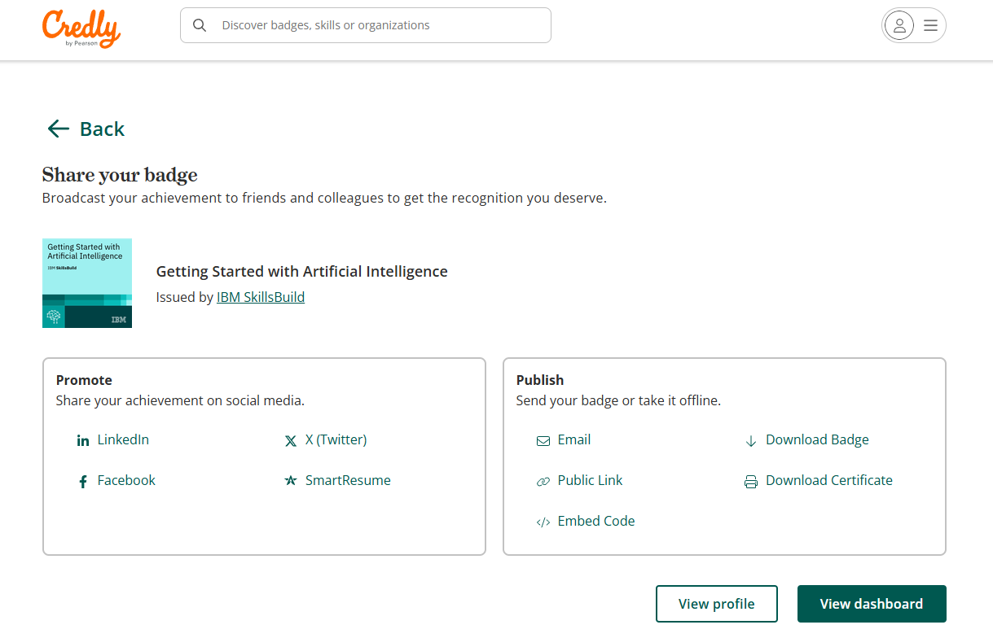
IBM Certifications
Screenshot/ credly certificate( getting started with AI)
https://www.credly.com/badges/0e483449-ef62-4530-966b-5ab6bc1675ff/public_url

Slide 15
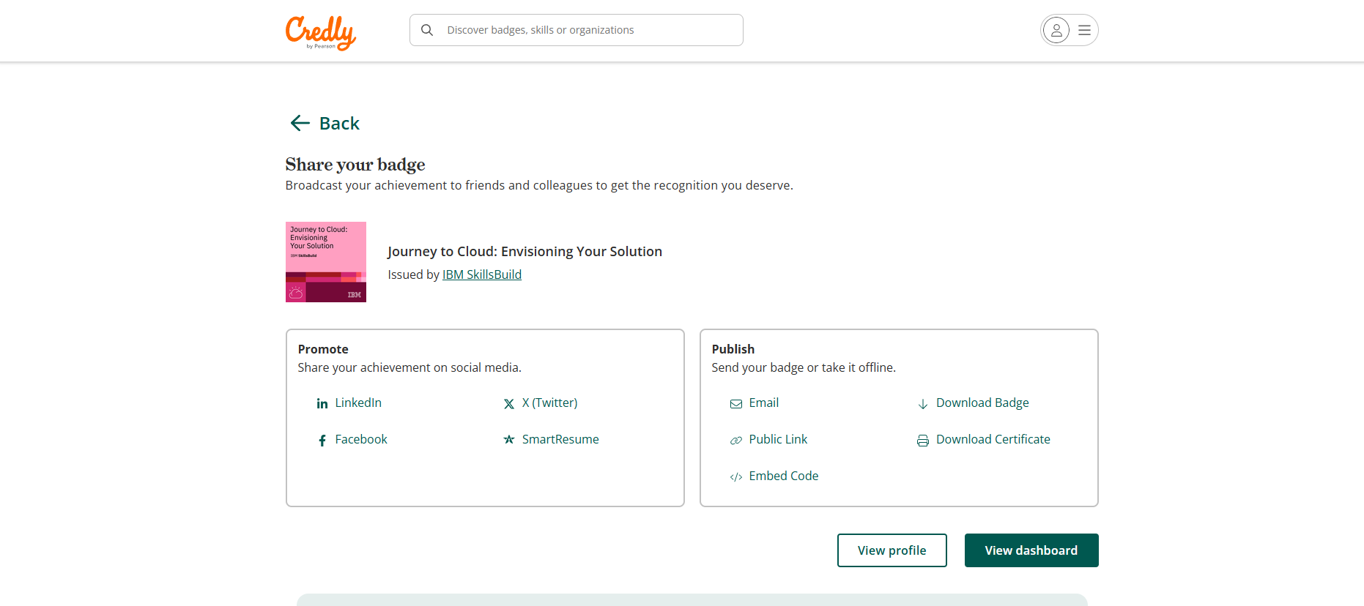
IBM Certifications
Screenshot/ credly certificate( Journey to Cloud)
https://www.credly.com/badges/f577094a-0add-4784-8fba-1869df2c5407/public_url

Slide 16
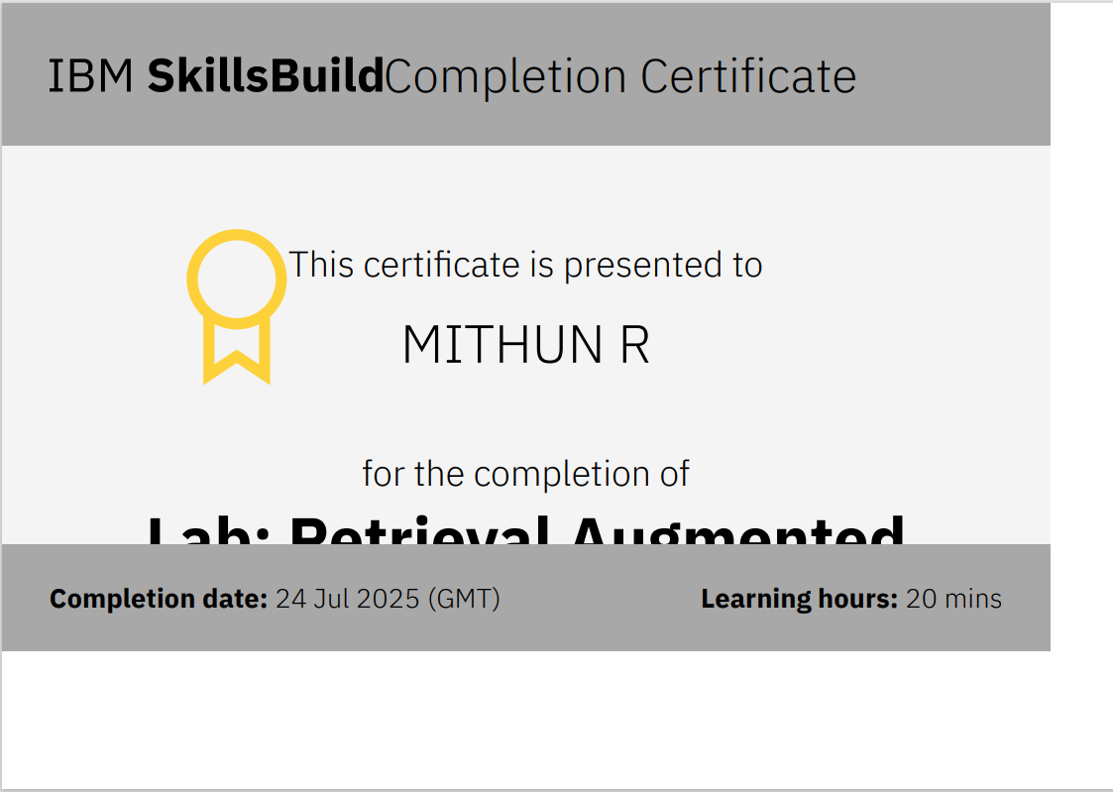
IBM Certifications
Screenshot/ credly certificate( RAG Lab)

Slide 17
THANK YOU

